Slide 1
Website Presentation
LIB2024 – Internet Applications
Andrew Kite
25 April 2018

Slide 2

Client that purchased my business services:
To design a website used to sell their product called: Redpages

Slide 3



Redpages is new technology for print books.
The pages of the book light up with a red-tinted glow to allow easy reading in the dark.

Slide 4
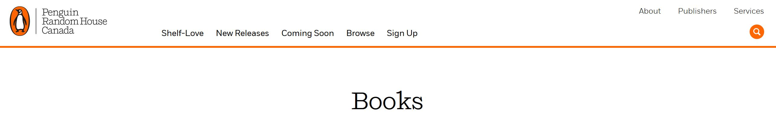
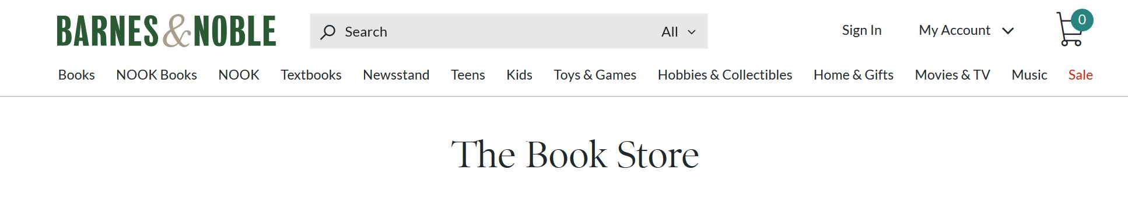
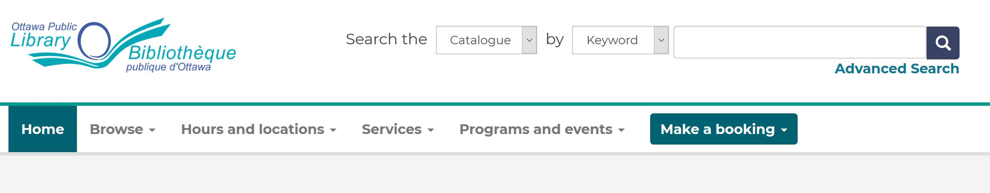
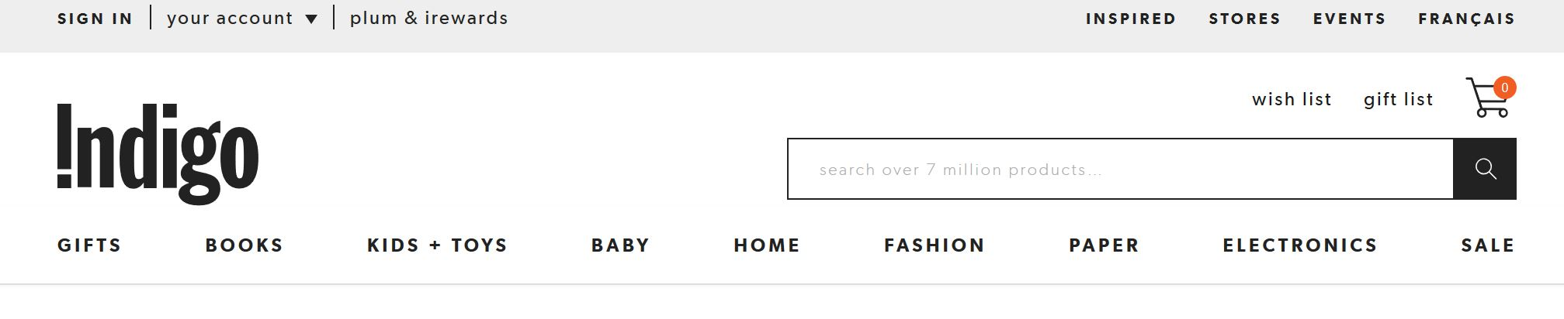
Initial research:

Slide 5
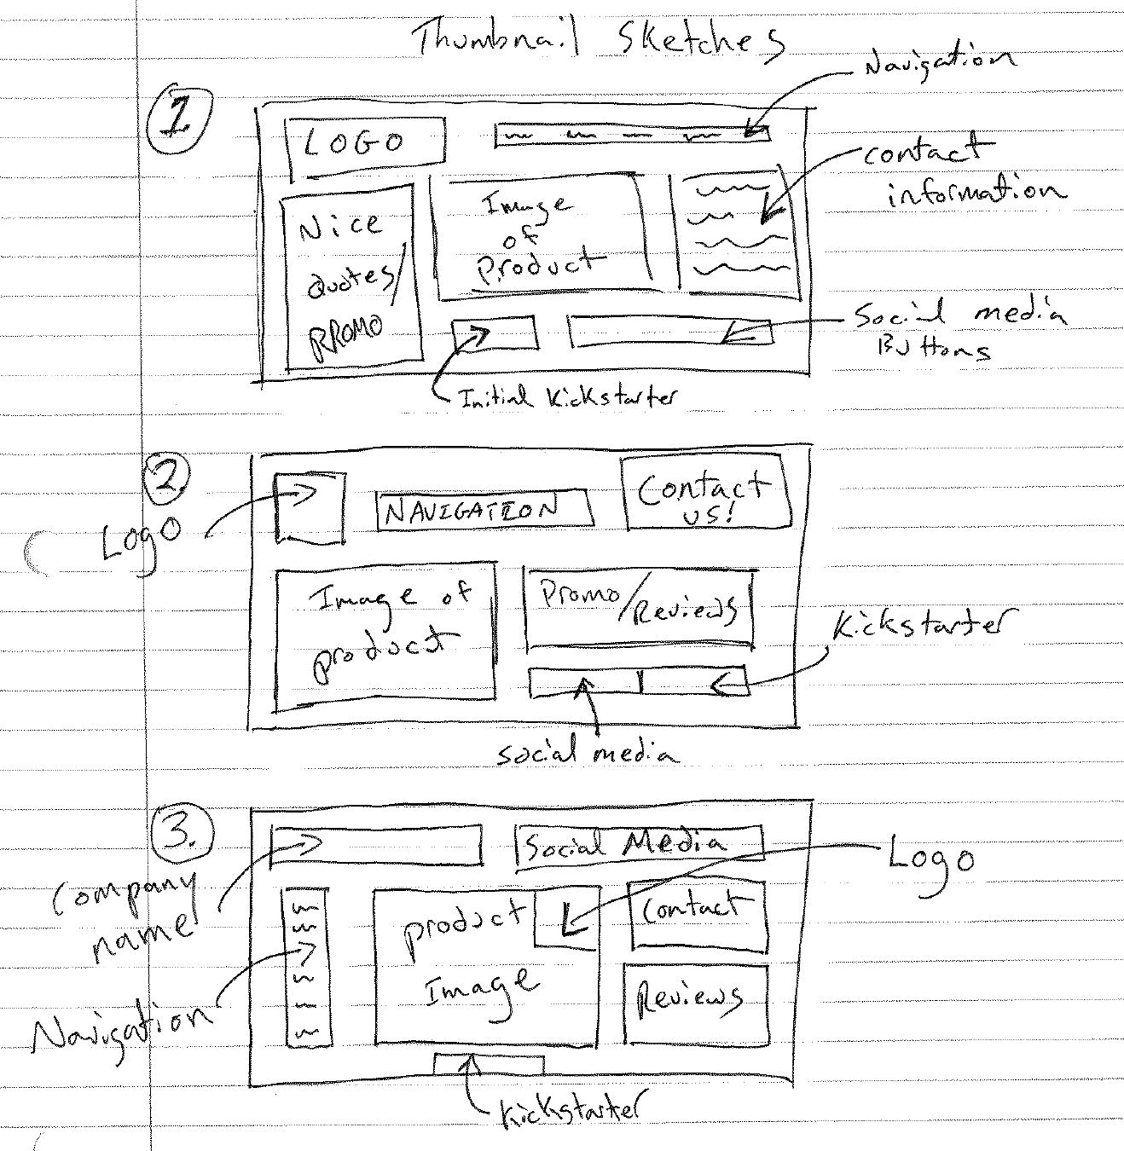
Sketches

Slide 6
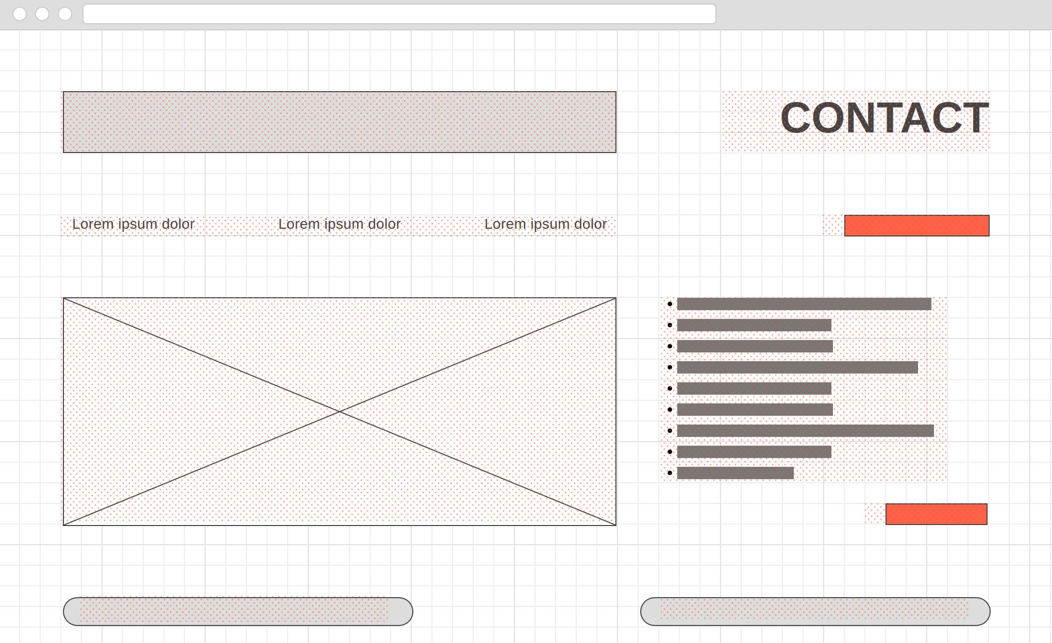
Wireframing: Desktop

Slide 7
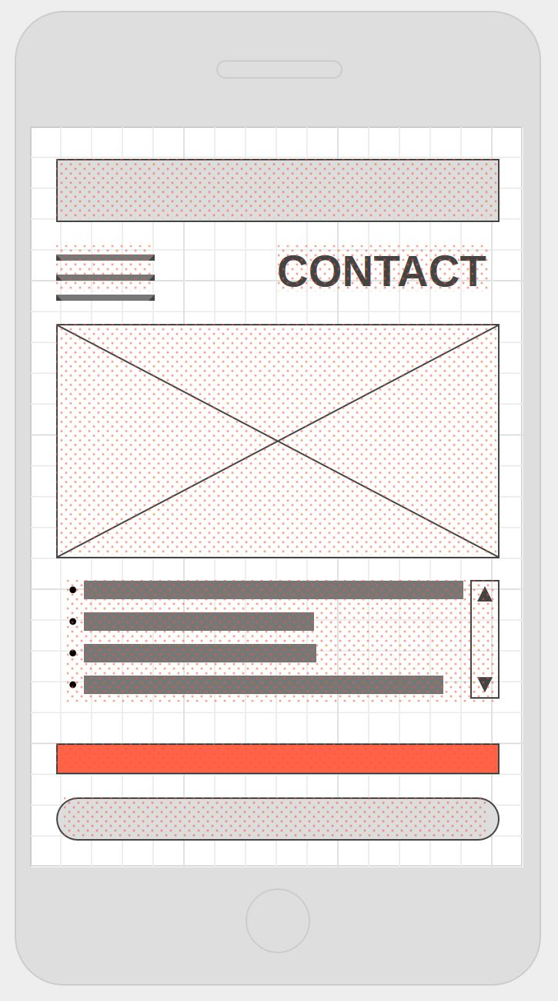
Wireframing: Mobile

Slide 8
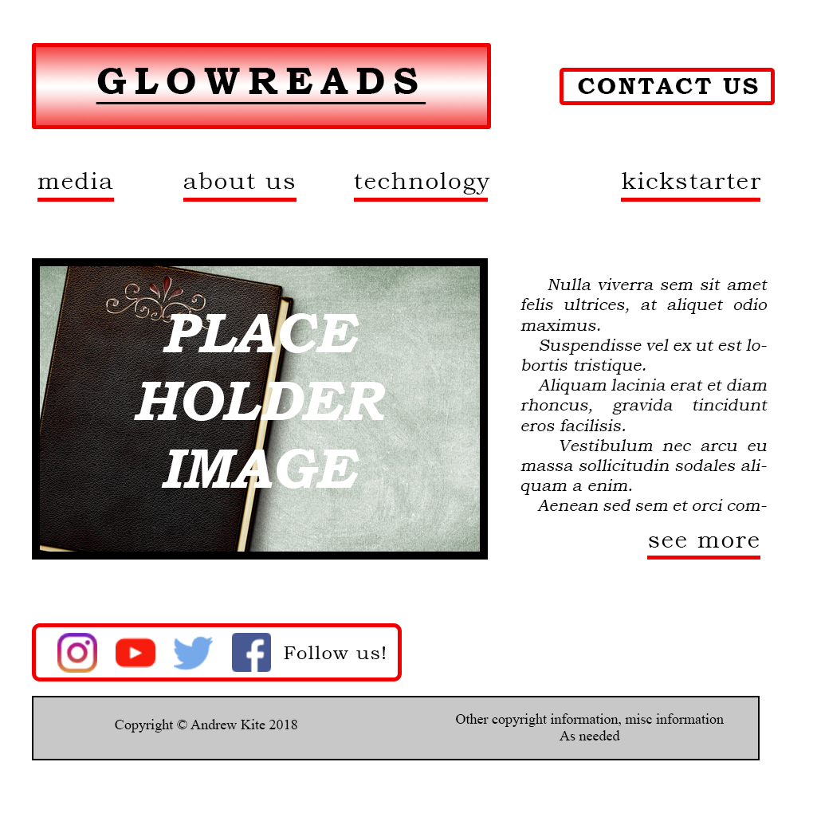
Mockup: Desktop

Slide 9

Mockup: Mobile

Slide 10
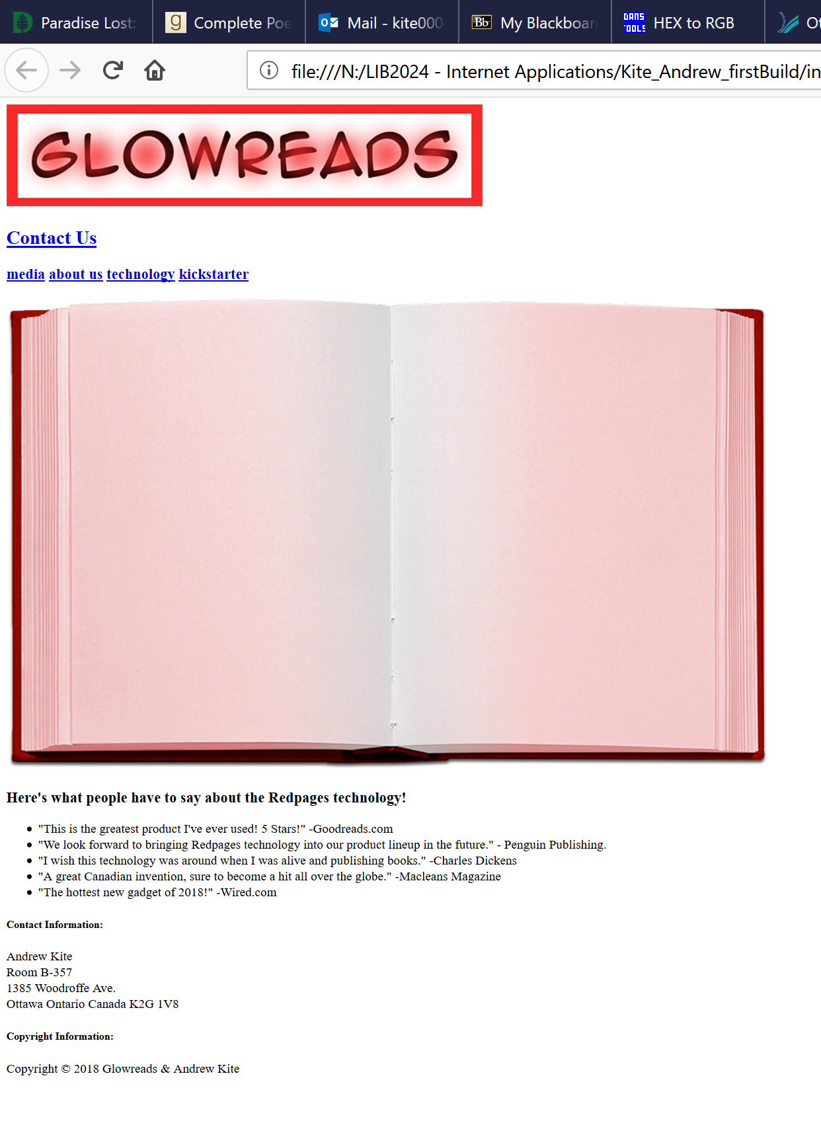
Firstbuild

Slide 11
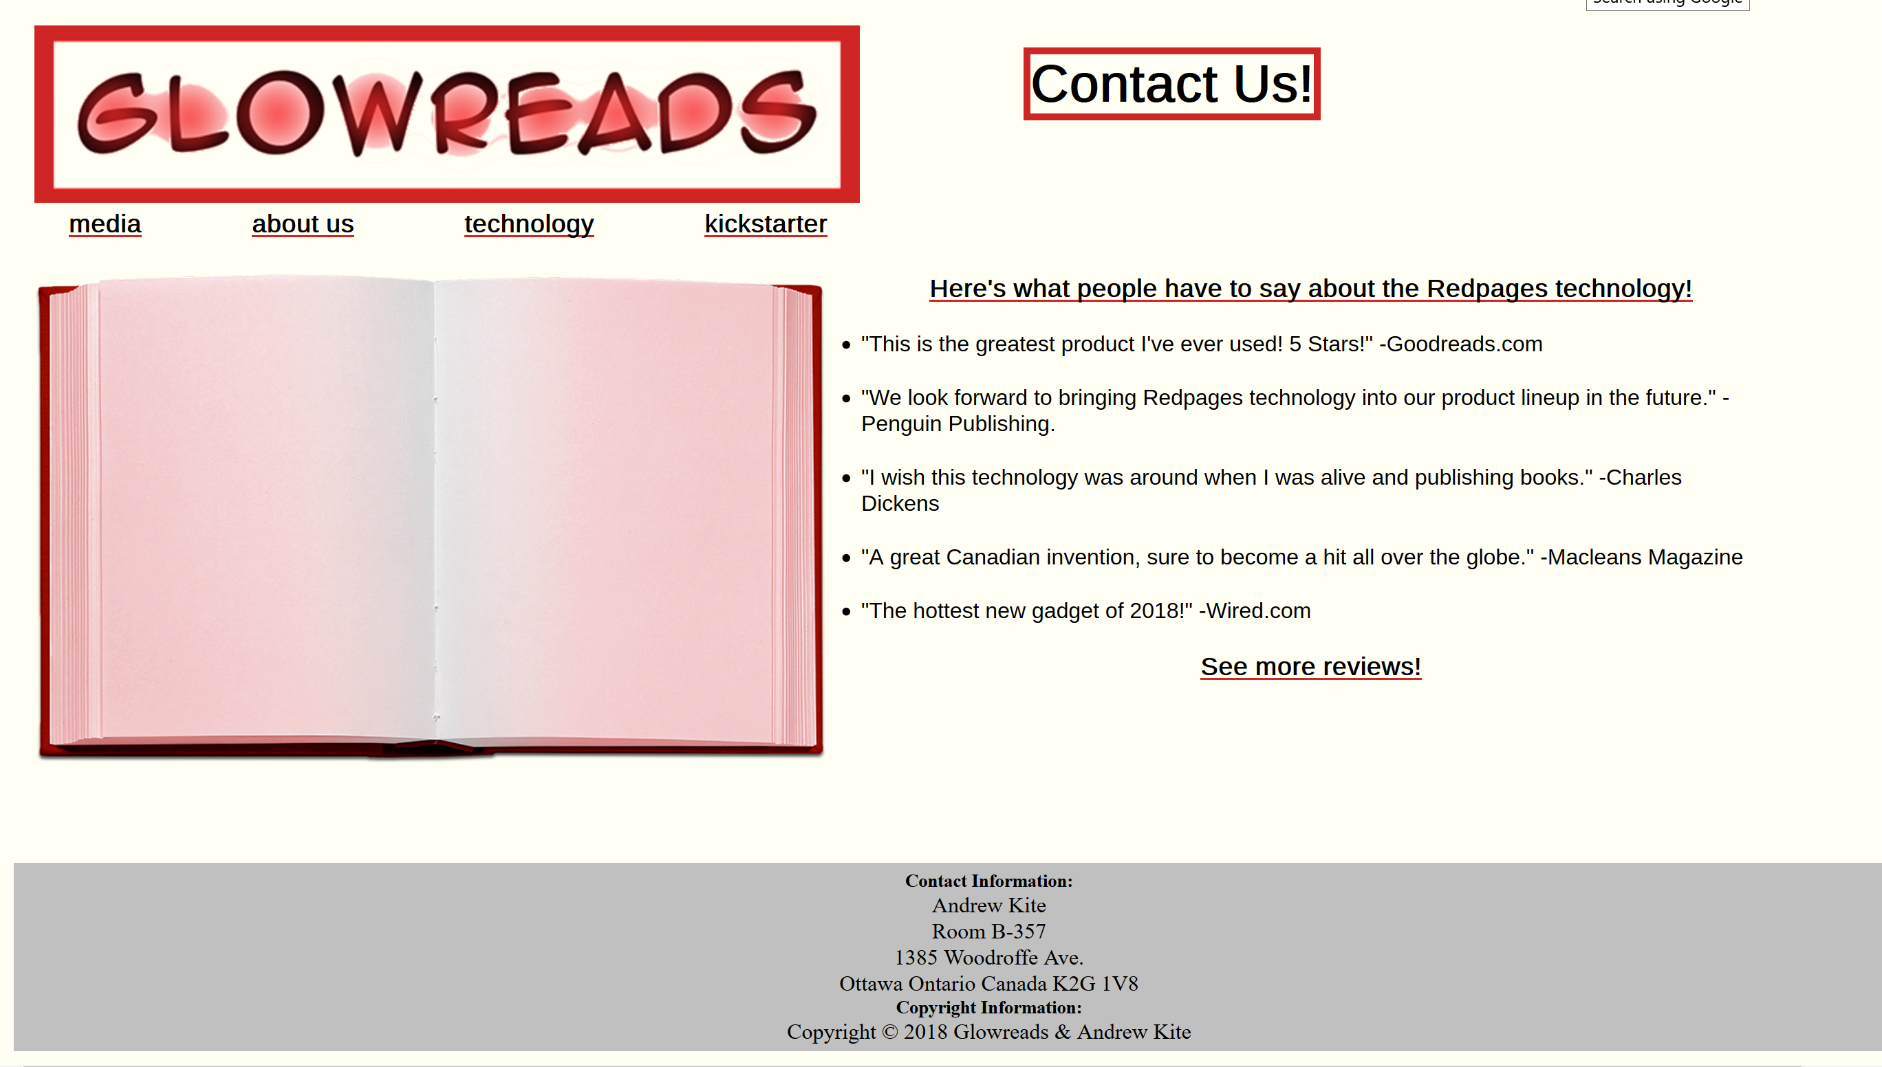
Final Homepage

